Slide 1
LISTING
PRESENTATION
LISTING PROPERTY
123 Main Street Jacksonville, FL 12345
Damaris Kruger
Realtor®
o: 904-337-1392
M: 904-580-1347
Dee@eaglesworldrealty.com
Damarishomes.com

Slide 2
SELLING A HOME
Selling a home in today’s market can be challenging - I understand that. While the market can be unpredictable, hundreds of homes are sold each week in the Jacksonville area. What’s the difference between selling your home or failing to do so? The Details! Whether it’s our proven sales approach, effective marketing campaigns, or utilizing our extensive network, with the Eagles World Realty team, no detail is overlooked. I pride myself in the use of technology and innovation to maximize the exposure of your home. I’ve created this guide to help educate you as a Seller and empower you to make the right decision when selecting the best agent to market and sell your home.
When I say I am “redefining service in real estate,” I mean it! My clients come first. I will educate you on what needs to be done to successfully sell your home . There are many components to a successful real estate transaction; you can count on me to be there every step of the process and make sure no detail is overlooked. With a proven track record, the right skill set, and years of experience, the Eagles World Realty Team has the right tools to successfully sell your home. If you’re serious about selling your home, I am serious about getting the job done!
Now more than ever, who you work with matters!

Slide 3
Appt Date: |  |  | Time:
Referred By: |  |  | Phone:
Sellers Name: |  |  | Email
Desired Price:
Key box #
Introduce team
Packet of info
Property sign
Professional Pictures
Brokers open
Unique Open house
If you go on vacation
Weekend Offers
Send all offers through ___________________
What is staying in the property
Leased fixtures
Updates: weekly reports
Communication
HOA & utilities Info
All payments must be up to date
Short Sale (Packet)
Remarks
Date to put on MLS:
Marketing Remarks
List here
Runner
List here
Pets
Not everyone is a pet person and some people do not like to view a house with the pets. Please, if possible, temporarily remove your pets and make sure the house is clean.
Showing Restrictions
Do we have any showing restrictions
List here

Slide 4
THE HOME SELLING PROCESS

Slide 5
THE HOME SELLING PROCESS
Each step of the homebuying process plays a crucial part in your selling experience. The right agent will help minimize the stress and maximize the price you get for your home in the shortest amount of time. Here’s how:
Step 1
Step 2
Step 3
Step 4
Step 5
Step 6
Hire an Agent
Determine Price
Prepare the House
Start Marketing
Virtual Showings
Accept Offer
Finding the right agent means hiring an expert who helps
you navigate the selling process easily.
You and your agent will look at the local market and help find the best asking price for your home.
It’s time to make your home look its absolute best before hitting the market-landscaping, cleaning & decluttering help.
An excellent realtor will know how and where to market your house to get the most viewings possible.
I will figure out a strategy that allows potential buyers to see your home safely and within current laws.
Once offers are received, your agent will help you negotiate price as well as requests for repairs and credits.

Slide 6
THE HOME SELLING PROCESS
How it Works
Start
Evaluate your needs
Set the right price
Determine time frame
Sign disclosures
Get showing feedback and make adjustments
Show to potential
buyers
Prepare your
Property for sale
Implement a customized marketing plan
Receive offers
Negotiate offers
Accept offer
Sign contract
Assist with
title process
Assist with
inspection process
Assist with
mortgage process
Begin
closing process
Final
walk-through
Assemble all documents and attend closing
Proceeds check
delivered to you
Property sold

Slide 7
ASKING PRICE VS. SELLING PRICE
Strategically pricing your home is vital to getting it sold for the most money in the least amount of time.
Buyers
desired range
Market
price range
Sellers
desired range
Price too high and you lose buyers.
Price lower and create momentum for “highest & best” with the lack of inventory.

Slide 8
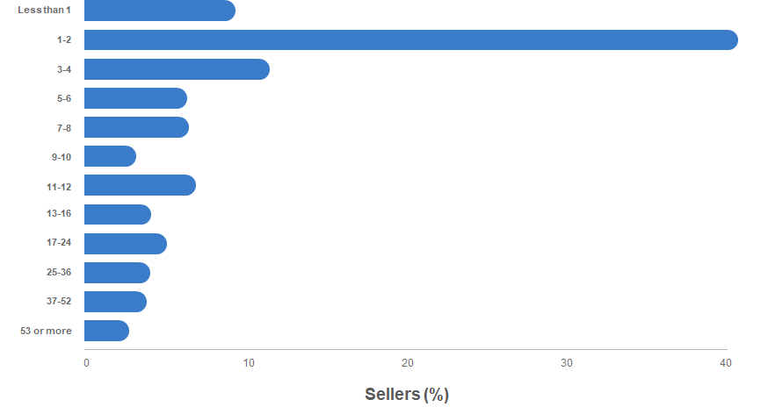
Critical Weeks When Listed
Pricing correctly helps you land a deal while competition for your home is hot.
Number of weeks recently sold home was on the market

Slide 9
How Do I Make YOUR Home Stand out From the Crowd?
EAGLES WORLD REALTY LISTING PRESENTATION
Team Approach
Professional Photography
Preparing the Home for Sale
Proper Marketing to the Ideal Buyer/ Eliminate the viewers.
Exposure, Exposure, Exposure
Proven Pricing Strategy
Coming Soon Campaign
Broker Tour
Open House
Brokerage Networking
Videos, Videos and More Videos
Aerial Drone Video and Photography
Staging

Slide 10
TEAM APPROACH
A team will always outperform an individual. With this mantra in mind we offer a team of dedicated professionals with years of experience in real estate, marketing, and service to ensure that every client gets a high level of dedication.
OUR APPROACH
PROFESSIONAL PHOTOGRAPHY
The saying “a picture is worth a 1,000 words” could not be more-true in real estate. In a world where approximately 90% of home buyers first see the property online, great photos are imperative. You only have one time to make a great first impression and that is why I hire the best real estate photographers in the area — to create the best first impression possible and to help your listing stand out amongst the thousands of online listings.
PREPARING THE HOME FOR SALE
As I mentioned above, first impressions are critical to success in real estate. In order to get buyers through the door we need to present the home as best as we can through preparation and staging. This can include decluttering, moving or removing furniture, minor repairs, and painting. I consult with my sellers on properly preparing the home for sale and will also use our professional stager, when needed, to ensure the best impression for buyers and their agents.
PROPER MARKETING TO THE IDEAL BUYER
Who is the ideal buyer for your home? That is a critical question to ask when marketing a home for sale as it will determine how and where you advertise the home. Knowing who is likely to buy your home can shorten the time it takes to sell and can lead to higher offers. I take pride in knowing who that ideal buyer is and how to reach them across marketing multi-channels.

Slide 11
OUR APPROACH
Exposure, Exposure, Exposure
Once I have the home prepared, take great pictures, and start to market it to the ideal buyer, I want to expose your home to the most amount of people possible. This is not as simple as putting the home on the internet. Through proper placement, target marketing, email, phone calls, videos and social media I have had tremendous success increasing the awareness of listings resulting in quicker sales.
Proven Pricing Strategy
There are many different approaches when pricing a home, some good and some not so good. I try to position a home on pricing so that it is the most attractive home at a particular price point. We want buyers who can afford the home to view it as a great value to first get them in the door for a showing and second to make an offer. With this strategy I aim to cause multiple offers to drive the price up instead of negotiating the price down.
CONTINUED
Coming Soon Campaign
A proven Coming Soon Campaign can produce awareness and excitement about a home before it even hits the market. I accomplish this through multiple channels of marketing including email, social media, the MLS, and more. The idea is to create awareness about a home to drive traffic to the open house and private showings.

Slide 12
OUR APPROACH
Broker Tour
Broker tours are a great way for local agents to keep up with what has come on the market. I make this event extra interesting by providing lunch and drinks for all the brokers and agents that attend. I find this to be a valuable resource to show the home, as well as get feedback on condition and price.
Open House/ Virtual Open House
Open houses are a time-tested strategy for getting traffic to a home. I feel they are a great way to introduce a property to the market and I frequently use this as the first showing for a new listing. This goes along with creating a buzz from the Coming Soon campaign.
CONTINUED
Local Brokerage Networking
Part of creating awareness for a new property is communicating with local real estate agents who have recent sales in the area and who have buyers looking for homes in your neighborhood. I actively market my properties through email, reverse prospecting (finding the agents who have buyers looking for a home like yours), phone calls, and social media to ensure that as many agents as possible know about your home as it hits the market.

Slide 13
SOCIAL MEDIA & TECHNOLOGY
In today's world it is impossible to ignore the impact social media has had on our industry. That is why I have been an early adopter of social media like Facebook, Instagram, and Twitter to expose our listings and our message.

Slide 14
HOME SALE TIMELINE
Pre-Listing, Listed,, Under Contract and Closed
Broker Open House
Open House
Offer(s) Received
Offer(s) Negotiated
Offer Accepted
Disclosures Completed
Inspection Completed
Appraisal Completed
Contingencies Removed
Property Closes
Refer Friends and Family
Schedule an Appointment
Meet with My Team
Discuss Best Strategy For Selling
Formal Listing Presentation
Executed Sales Agreement
Property Evaluation
Market Analysis Completed
Sales Price Established
Prepare Home for Sale
Perfect 1st Impression
Coming Soon Listings
Eagles World Realty Sign Installed
Lockbox Installed
Listing Entered Into MLS
Marketing Campaign Launch
Property Website Launch
Property Brochure Delivery
Telephone Campaigns Launch
Email Campaigns Launch

Slide 15
TESTIMONIALS

Slide 16
TESTIMONIALS

Slide 17
WHY MARKETING MATTERS
Being a great real estate agent means knowing more than how to do the paperwork.
My advanced marketing plan means the maximum amount of exposure for your home across the highest trafficked real estate listing websites.
My goal is to make your experience as seamless and stress-free as possible so you can feel confident in your home selling decisions.

Slide 18
DIGITAL MARKETING
THE MOST EXPOSURE
I will put your home on multiple sites to maximize interest across a variety of platforms.
VIRTUAL TOURS
Times may be weird, but I’ve adapted my “showing: strategy to include virtual tours so potential buyers from all over the world can still do a walkthrough.
EMAIL NEWSLETTER
Your listing will be added to my email newsletter and sent to my constantly growing contact list.

Slide 19
YOUR HOME’S
DIGITAL FOOTPRINT
Your home will appear on all the following top real estate search sites including:
Website.com
Website.com
Website.com
Website.com
Website.com
Website.com

Slide 20
OPEN HOUSE & VIRTUAL OPEN HOUSE STRATEGY
51%
Open houses can be a powerful way to showcase your home to potential buyers.
Following the guidelines, we currently perform regular open houses for the sellers who request it. In respect to our new normal, we also do virtual open houses for all of those potential buyers that prefer not to visit a regular open house.
Here are a couple ways I maximize my virtual open houses:
of homebuyers attend open houses in their home search.
Social Media
Youtube
Email
Direct Mail
Zillow

Slide 21
COVID SAFETY PROTOCOL
We follow the general NAR COVID-19 guidelines. In the means of protecting you and your family, we take precautions in all we do. Anyone entering the home MUST follow social distancing guidelines and wear a mask. It is part of our protocol for my team members to carry extra masks to provide to anyone that shows up without one. We ask everyone who is viewing the home to keep their hands to themselves and not touch anything.
A Safe Approach to COVID-19
LIST OF SAFETY QUESTIONS
We ask a series of questions to everyone prior to viewing the property. Should they answer yes to any, they will not be allowed to enter your home.
Have you tested positive to Covd in the last 2 weeks?
Have you had fever or any Covid symptoms in the last 2 weeks?
Have you traveled outside of the US in the last 2 weeks?
EXTERIOR VIEWINGS
We advise all buyers to drive by the property and view both the neighborhood and the exterior of the home before scheduling an appointment to view the inside. This eliminates buyers that are not interested in the home prior to viewing it.
QUALIFIED BUYERS ONLY
Prior to scheduling a viewing, all buyers that come with an EWR agent will be qualified. We add this information on the private remarks of the listing on the MLS, to ensure that any agent interested in bringing a buyer to your property follows the same protocol.

Slide 22
98%
CLIENT SATISFACTION
Results based on my client survey.
WHAT THIS MEANS FOR YOUR HOME
21
DAYS ON THE MARKET
The average for this area in the last 2 months.
15%
OVER LISTING
The average amount my homes sell over listing price.
More exposure
More knowledge of market
More innovative marketing tactics
More interest from prospective buyers
A seamless virtual selling experience

Slide 23
I look forward to selling your home!
Damaris Kruger
Realtor®
o: 904-337-1392
M: 904-580-1347
Dee@eaglesworldrealty.com
Damarishomes.com

